Slide 1
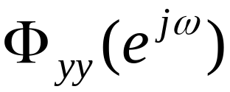
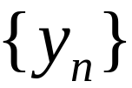
Power Spectral Estimation
The purpose of these methods is to obtain an approximate estimation of the power spectral density of a given real random process

Slide 2
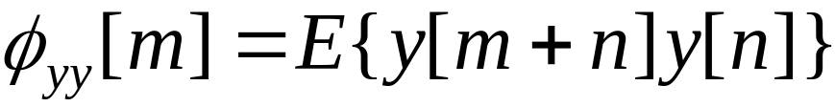
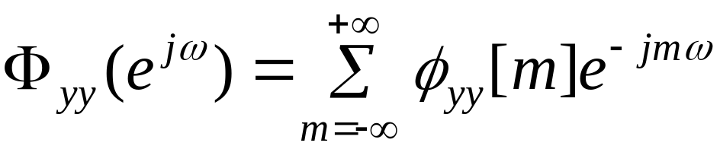
Autocorrelation
The autocorrelation sequence is
The pivot of estimation is the Wiener-Khintchine formula (which is also known as the Einstein or the Rayleigh formula)

Slide 3
Classification
The crux of PSD estimation is the determination of the autocorrelation sequence from a given process.
Methods that rely on the direct use of the given finite duration signal to compute the autocorrelation to the maximum allowable length (beyond which it is assumed zero), are called Non-parametric methods
Methods that rely on a model for the signal generation are called Modern or Parametric methods.
Personally I prefer the names “Direct” and “Indirect Methods”

Slide 4
Classification & Choice
The choice between the two options is made on a balance between “simple and fast computations but inaccurate PSD estimates” Vs “computationally involved procedures but enhanced PSD estimates”

Slide 5
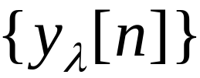

Direct Methods & Limitations
Apart from the adverse effects of noise, there are two limitations in practice
  Only one manifestation , known as a realisation in stochastic processes, is available
  Only a finite number of terms, say , is available

Slide 6

Assumptions
Assume to be
  Ergodic so that statistical expectations can be replaced by summation averages
  Stationary so that infinite averages can be estimated from finite averages
  Both of these averages are to be derived from

Slide 7

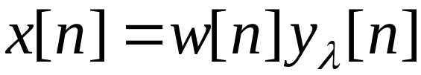

Windowing
Thus an approximation is necessary. In effect we have a new signal given by
where is a window of finite duration selecting a segment of signal from .

Slide 8
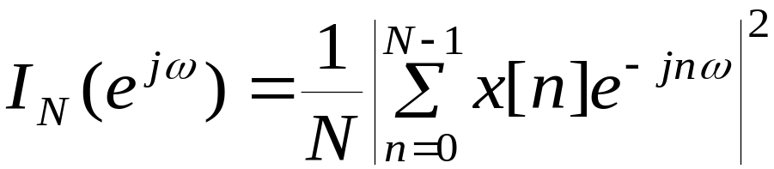
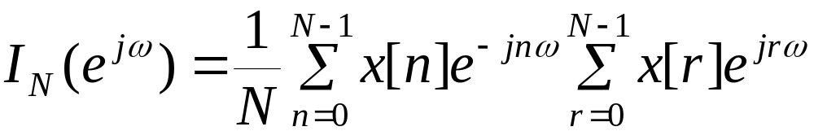
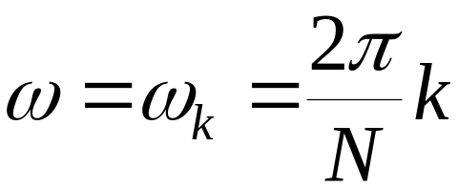
The Periodogram
The Periodogram is defined as
Clearly evaluations at
are efficiently computable via the FFT.

Slide 9
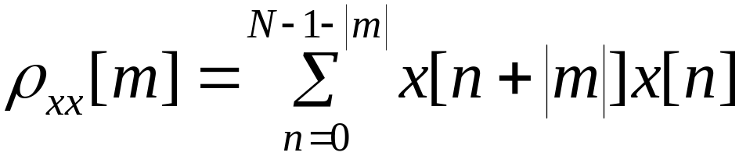
Limited autocorrelations
Let
which we shall call the autocorrelation sequence of this shorter signal.
These are the parameters to be used for the PSD estimation.

Slide 10
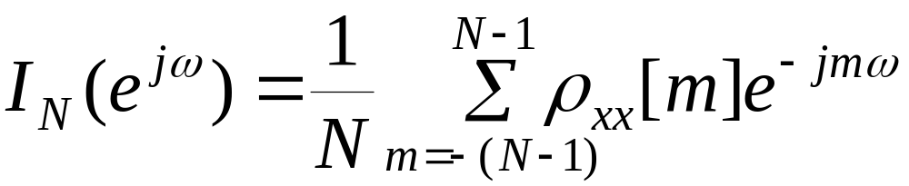
PSD Estimator
It can be shown that
The above and the limited autocorrelation expression, are similar expressions to the PSD. However, the PSD estimates, as we shall see, can be bad.
Measures of “goodness” are the “bias” and the “variance” of the estimates?

Slide 11
The Bias
The Bias pertains to the question:
Does the estimate tend to the correct value as the number of terms taken tends to infinity?
If yes, then it is unbiased, else it is biased.

Slide 12
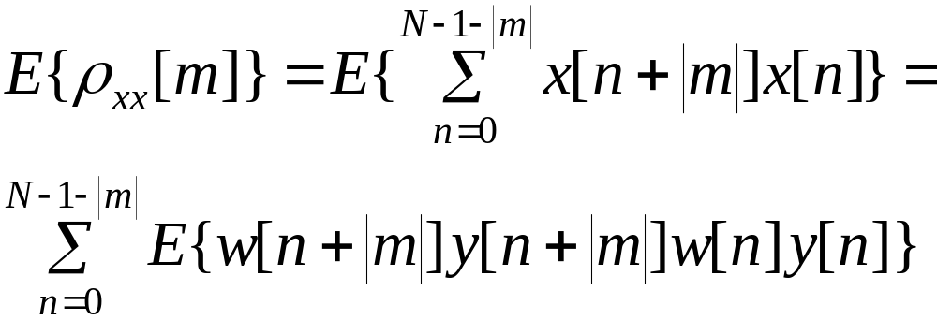
Analysis on Bias
For the unspecified window case considered thus far, the expected value of the autocorrelation sequence of the truncated signal is

Slide 13
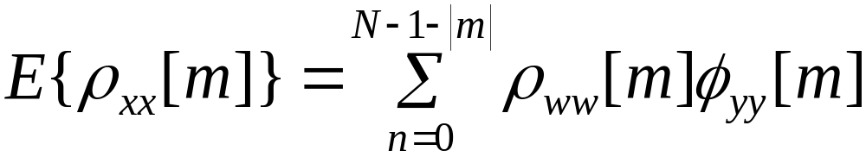
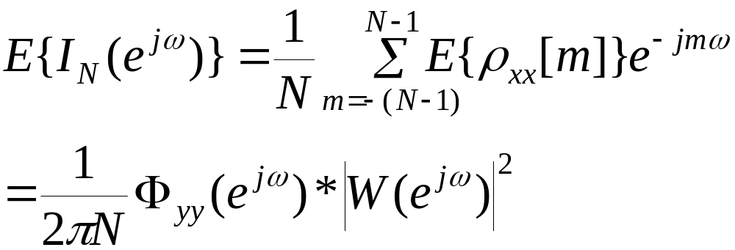
Analysis on Bias
or
Thus

Slide 14
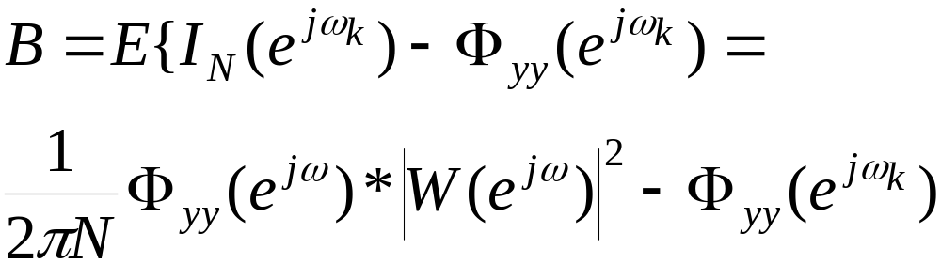
Analysis on Bias
The asterisk denotes convolution.
The bias is then given as the difference between the expected mean and the true mean PSDs at some frequency.

Slide 15
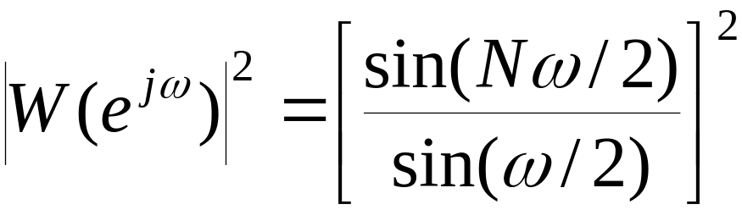
Example
For example take a rectangular window then ,
which, when convolved with the true PSD, gives the mean periodogram, ie a smoothed version of the true PSD.

Slide 16


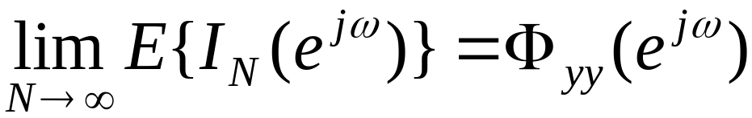
Example
Note that the main lobe of the window has a width of
and hence as
we have
at every point of continuity of the PSD.

Slide 17
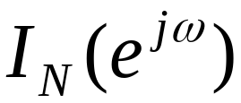
Asymptotically unbiased
Thus is an asymptotically unbiased estimator of the true PSD.
The result can be generalised as follows.

Slide 18
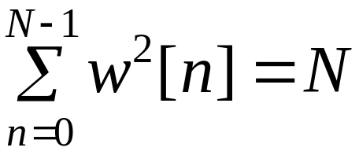
Windows & Estimators
For the window to yield an unbiased estimator it must satisfy the following:
1) Normalisation condition
2) The main lobe width must decrease as 1/N

Slide 19
The Variance
The Variance refers to the question on the “goodness” of the estimate:
Does its variance of the estimate decrease with N? ie does the expression below tend to zero as N tends to infinity?

Slide 20
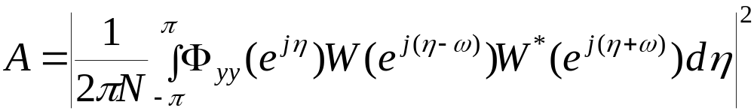
Analysis on Variance
If the process is Gaussian then (after very long and tedious algebra) it can be shown that
where

Slide 21
Analysis
Hence it is evident that as the length of data tends to infinity the first term remains unaffected, and thus the periodogram is an inconsistent estimator of the PSD.

Slide 22
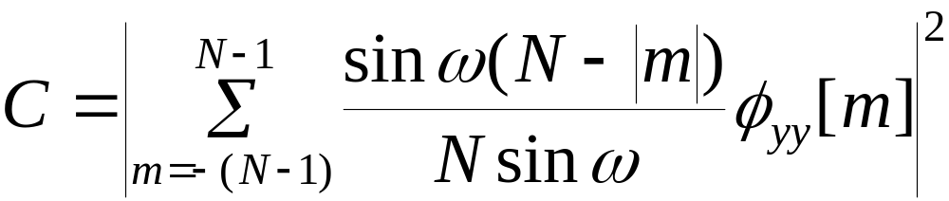
Example
For example for the rectangular window taken earlier we have
where

Slide 23

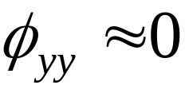
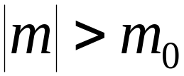
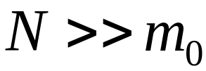
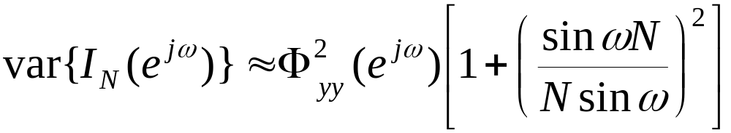
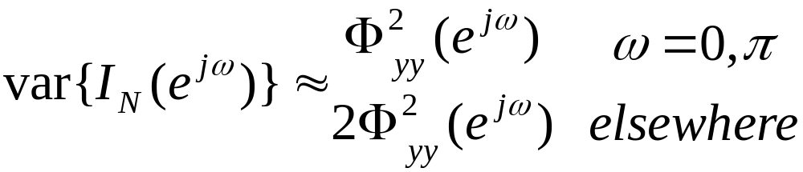
Decaying Correlations
If has for
then for we can write above
From which it is apparent that

Slide 24
Variance is large
Thus even for very large windows the variance of the estimate is as large as the quantity to be estimated!

Slide 25
Smoothed Periodograms
Periodograms are therefore inadequate for precise estimation of a PSD.
To reduce variance while keeping estimation simplicity and efficiency, several modifications can be implemented
a) Averaging over a set of periodograms of (nearly) independent segments
b) Windowing applied to segments
c) Overlapping the windowed segments for additional averaging

Slide 26




Welch-Bartlett Procedure
Typical is the Welch-Bartlett procedure as follows.
Let be an ergodic process from which we are given data points for the signal .
1) Divide the given signal into blocks each of length .
2) Estimate the PSD of each block
3) Take the average of these estimates

Slide 27
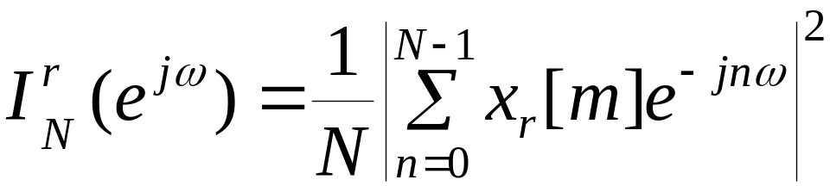
Welch-Bartlett Procedure
Step 2 can take different forms for different authors.
For the Welch-Bartlett case the periodogram is suggested as

Slide 28

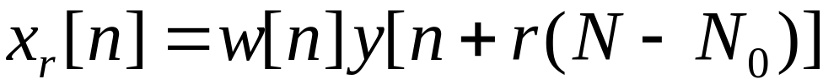

Welch-Bartlett Procedure
where the segment is a windowed portion of
And is the overlap.
(Strictly the Bartlett case has a rectangular window and no overlap).

Slide 29


Comments
FFT-based Spectral estimation is limited by
  a) the correlation assumed to be zero beyond the measurement length and
  b) the resolution attributes of the DFT.
Thus if two frequencies are separated by then a data record of length
is required.
(Uncertainty Principle)

Slide 30
Narrowband Signals
The spectrum to be estimated is some cases may contain narrow peaks (high Q resonances) as in speech formants or passive sonar.
The limit on resolution imposed by window length is problematic in that it causes bias.
The derived variance formulae are not accurate

